Slide 1











BY
Pasindu Mahima
Search . . .
NGATOR
LEARNING
SAD PRESENTATIONS
learn.ngator.com

Slide 2




BY
Pasindu Mahima
Search . . .
IMPORTANT POINTS TO REMEMBER
JAVA GUI COMPONENTS
AND LAYOUTS
JAVA LIBRARIES
JAVA DATA STRUCTURES
BASIC PROCESSES
Arrays
Vectors
HashMap
Java AWT Components
Java Swing Components
Adding data to a Table
Adding items to a Combo Box
MySQL
Jasper Reporting

Slide 3
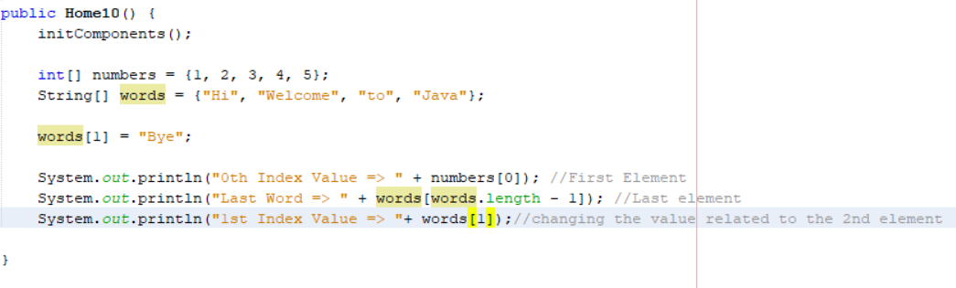
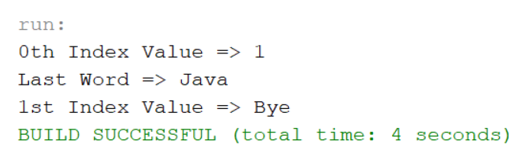
BY
Pasindu Mahima
Search . . .
ARRAY

Slide 4
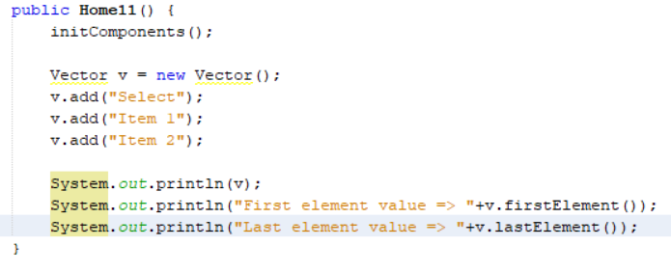
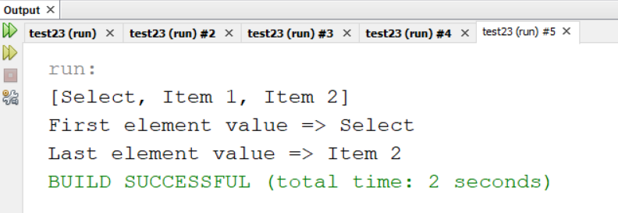
BY
Pasindu Mahima
Search . . .
VECTOR

Slide 5
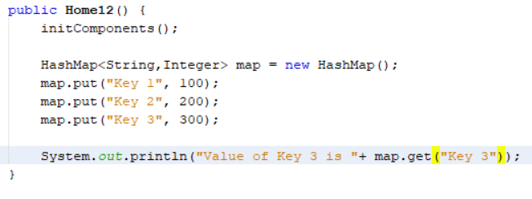
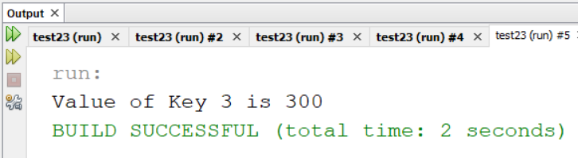
BY
Pasindu Mahima
Search . . .
HASHMAP

Slide 6
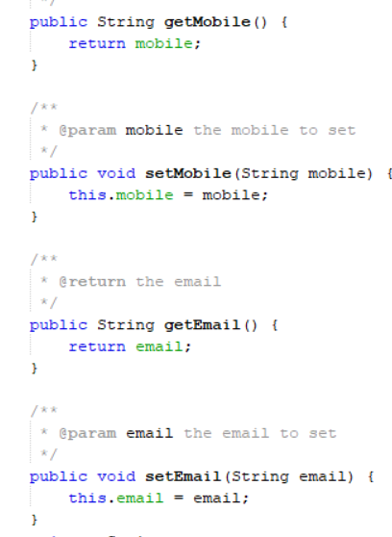

BY
Pasindu Mahima
Search . . .
JAVA BEAN

Slide 7

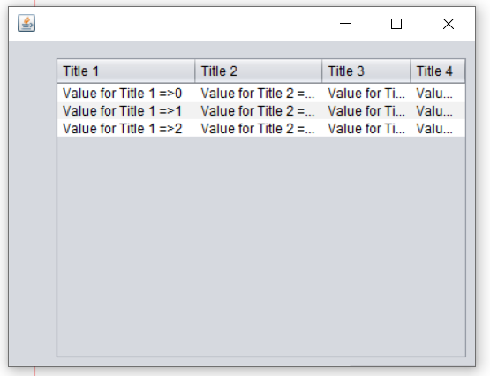
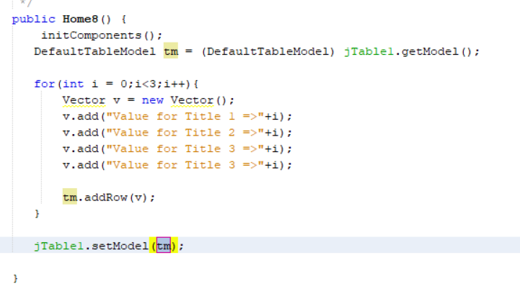
BY
Pasindu Mahima
Search . . .
ADDING DATA TO A TABLE

Slide 8

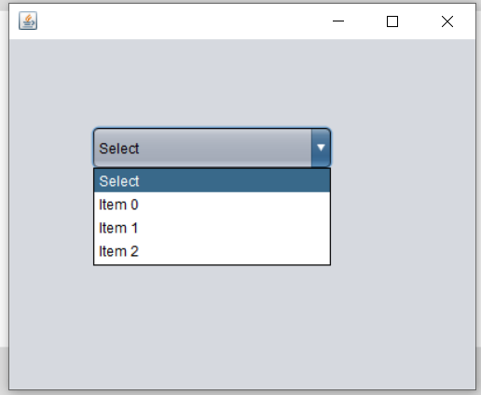
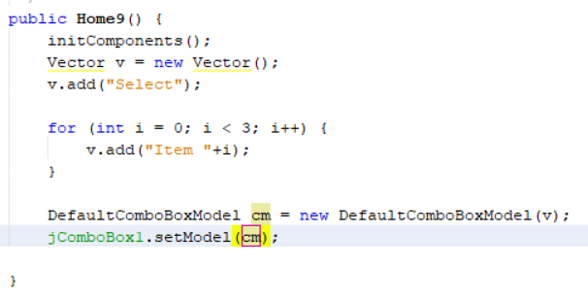

BY
Pasindu Mahima
Search . . .
ADDING ITEMS TO A COMBOBOX

Slide 9

BY
Pasindu Mahima
Search . . .
THANK YOU
Social Profiles
Follow Ngator on social networks
Facebook : https://www.facebook.com/learnwithngator
Instagram :https://www.instagram.com/mahimapasindu/
GitHub : https://github.com/drgnhunter
LinkedIn : https://www.linkedin.com/in/pasindu-mahima-3a0031187/
END SLIDE

